Slide 1
2021 ABCP Annual Conference: UK - China Collaboration Track
Joint institutes and research collaboration between HEIs in the UK and China
Professor Sue Welburn
Executive Dean, Zhejiang University – University of Edinburgh Joint Institute
UK Chair, UK-China Joint Institute Alliance

Slide 2
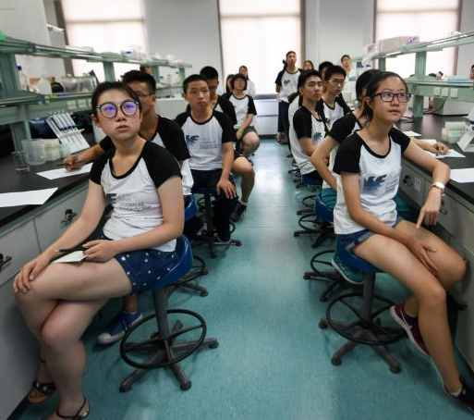

Slide 3
Academically led strategic world class partnership for research and teaching
JI - Education and research platform
Exceptional talent - >1000 - UG & PG students
Leading international faculty & staff >100
BSc/MSc/PhD created de novo, together
2016 Biomedical Sciences; 2018 Biomedical Informatics
PG – Dual award and UoE and Zhejiang single awards
International Campus with state-of-the-art teaching, learning and research and recreational facilities
Scholarships & 1st class student support

Slide 4
Hub for collaborative biomedical research
Research led teaching demands leading international faculty
City-deal start ups for new faculty
Generous housing allowances/Talent awards
Exceptional research facilities
Access to 1000 Post doc hire scheme
Pull through UG talent – 90% UG enter PG most with scholarships to Global 100
PG - high quality students China/Global
Opportunity for collaboration £5m SAHZU

Slide 5
Challenges
Scale, strategy and ambition of partnership
Appreciating & managing “difference”
Quotas – students and research
Mobility in times of COVID-19
Bi-lateral funding initiatives in basic and translational research
Learning and sharing best practice

Slide 6
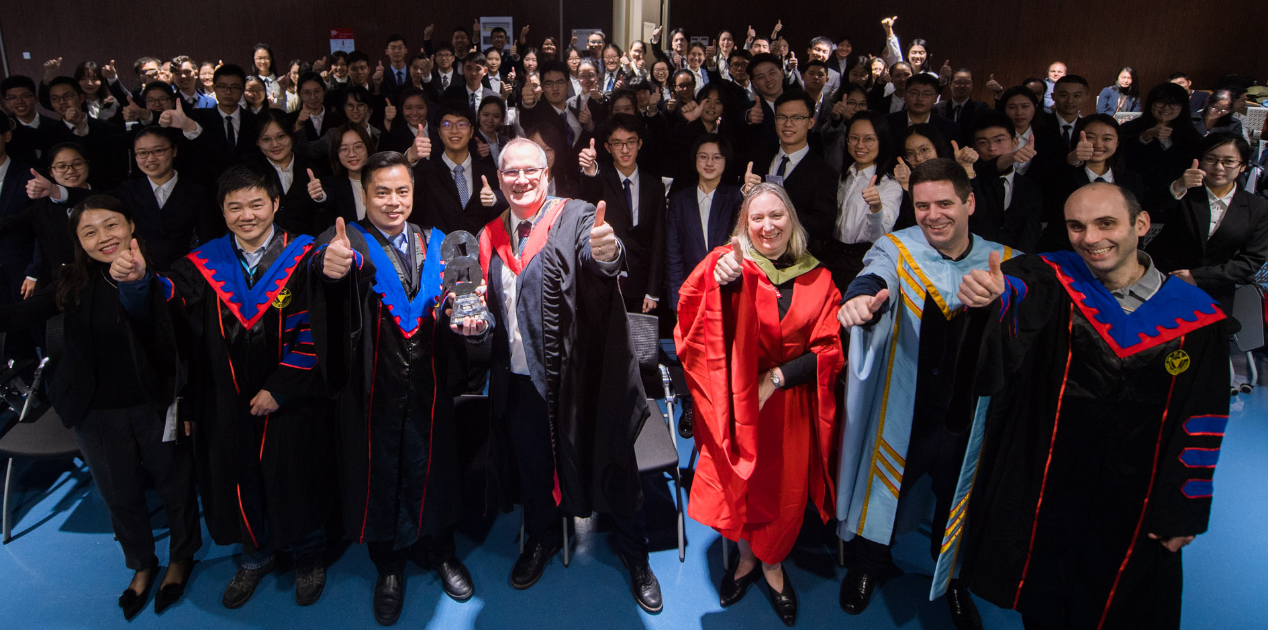
Educational Institutional Partnership of the Year

Slide 7
UK- China Joint Institute Alliance
Supported by British Council and China Education Association for International Exchange.
Platform for UK and Chinese institutions to shape and share best practice and know-how in TNE; explore, research and resolve issues arising from such complex partnerships.
Offers support in QA and innovation for sustainable TNE delivery ensuring that teaching, student experience and faculty collaboration is of the highest quality.
Pursues collaborative work on key topics that generates new knowledge
Boosts practitioner engagement to support the development of UK-China TNE and research policy.
34 UK China JIs.

